Slide 1


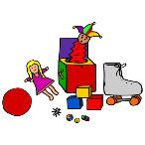






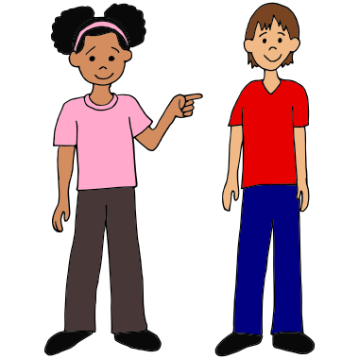


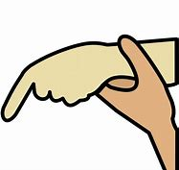
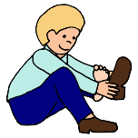
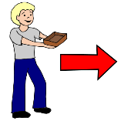
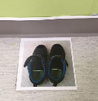
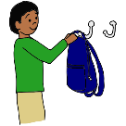
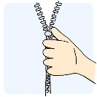
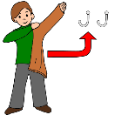
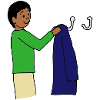
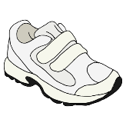
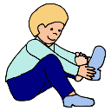
Entry Routine - detailed
Pause
Non-Verbal Prompt
Environmental Cues
Open-Ended Question
Visual Prompt
Give 2 Choices
Model
Partial Physical
Physical Prompt (hand-under-hand)
Adult Completed Task
 | Shoes off | Carry Shoes | Shoes Away | Hang up Backpack | Unzip Coat | Coat off | Hang up coat | Open Velcro | Inside shoes on | Close Velcro
Least
Invasive
Most Invasive
Oct 2019

Slide 2
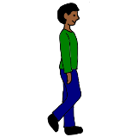
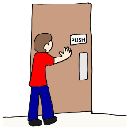

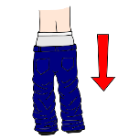
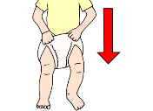
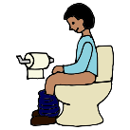
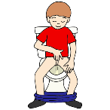
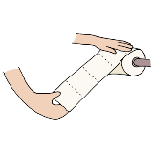
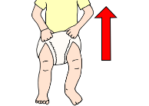
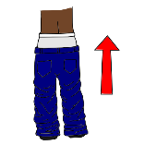
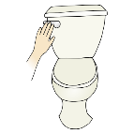
Template Toileting Routine
Pause
Non-Verbal Prompt
Environmental Cues
Open-Ended Question
Visual Prompt
Give 2 Choices
Model
Partial Physical
Physical Prompt (hand-under-hand)
Adult Completed Task
 | Walk to bathroom | Push open door | Turn on light | Pants down | Underwear Down | Sit on toilet | Go pee | Wipe | Underwear Up | Pants up | Flush
Least
Invasive
Most Invasive
Oct 2019
walking to the bathroom -

Slide 3
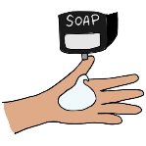
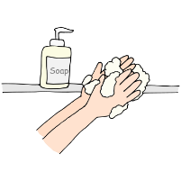
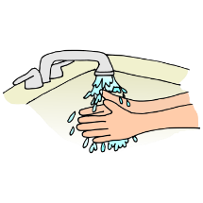
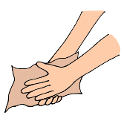
Hand Washing (in Bathroom)
Pause
Non-Verbal Prompt
Environmental Cues
Open-Ended Question
Visual Prompt
Give 2 Choices
Model
Partial Physical
Physical Prompt (hand-under-hand)
Adult Completed Task
 | Get Soap | Scrub | Rinse hands | Dry hands
Least
Invasive
Most Invasive

Slide 4
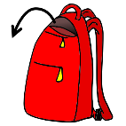

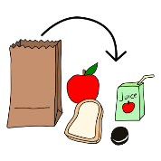

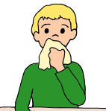


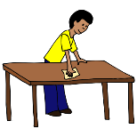



Lunch
Pause
Non-Verbal Prompt
Environmental Cues
Open-Ended Question
Visual Prompt
Give 2 Choices
Model
Partial Physical
Physical Prompt (hand-under-hand)
Adult Completed Task
 | Get lunch | Sit at table | Open lunch | Eat | Wipe face | Wipe hands | Lunch away | Clear off table
Least
Invasive
Most Invasive

Slide 5








Core Words
Pause
Non-Verbal Prompt
Environmental Cues
Open-Ended Question
Visual Prompt
Give 2 Choices
Model
Partial Physical
Physical Prompt (hand-under-hand)
Adult Completed Task
Least
Invasive
Most Invasive

