Slide 1

Visual schedule LAMP WFL 84
Save a copy of this file to your own computer to edit file
*DO NOT edit this original file
Print as is if you want original 20cm wide visuals
If you want to edit size of images:
  Click on image and drag to desired size, or
  Click on image then select Picture Format from the menu bar (to make to the exact size you want)
    you will see the height/width function on the menu to the right
If you want smaller images for a personal schedule, you can also print as handouts (e.g., 4 to a slide)
If you need additional images, not available here, speak to your SLP

Slide 2
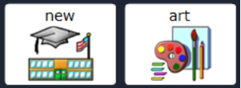
art

Slide 3
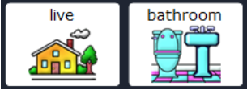
bathroom

Slide 4

Book/novel study

Slide 5
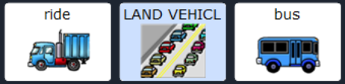
bus

Slide 6
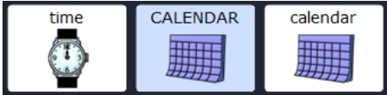
calendar

Slide 7
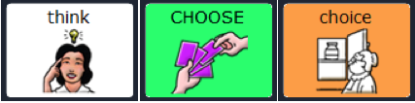
choice

Slide 8
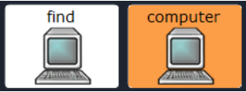
computer

Slide 9

dance

Slide 10
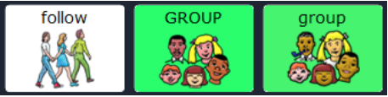
Group/circle time/meeting

Slide 11
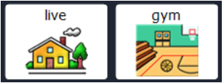
gym

Slide 12
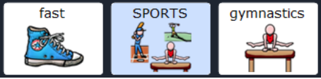
gymnastics

Slide 13
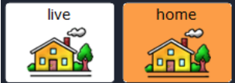
home

Slide 14
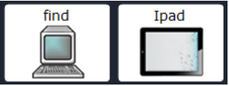
iPad

Slide 15
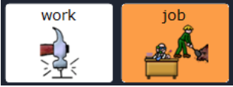
Job/housekeeping/vocational

Slide 16
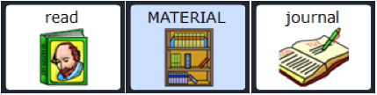
journal

Slide 17

library

Slide 18
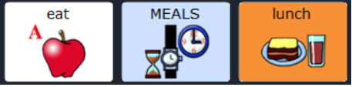
lunch

Slide 19
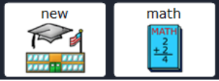
math

Slide 20
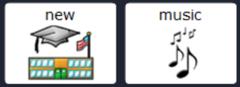
music

Slide 21
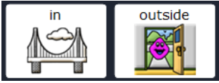
outside

Slide 22
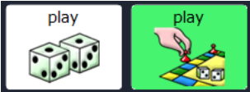
play

Slide 23
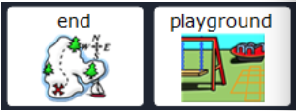
playground

Slide 24

read

Slide 25
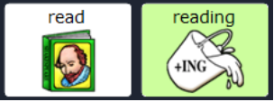
reading

Slide 26
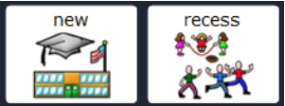
recess

Slide 27
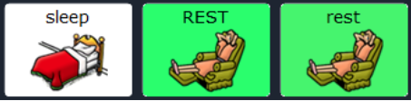
Rest/break

Slide 28
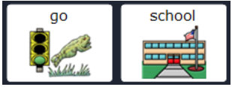
School

Slide 29
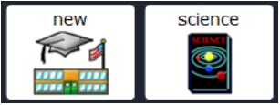
science

Slide 30
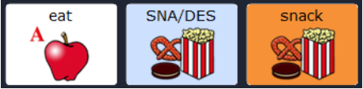
snack

Slide 31
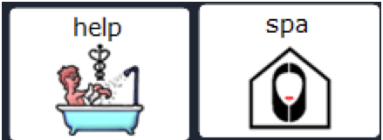
spa

Slide 32
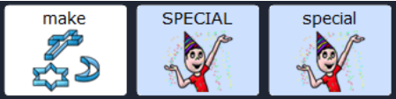
Special activity

Slide 33

story

Slide 34
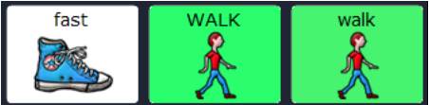
walk

Slide 35
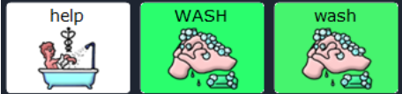
wash

Slide 36
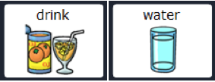
water

Slide 37
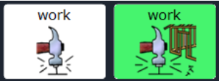
work

Slide 38
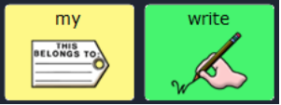
write

Slide 39
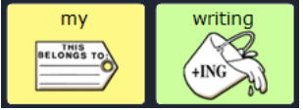
writing

Slide 40

Yoga/meditation

